Slide 1
Options and Bubbles
Authors: Steven L. Heston, Mark Loewenstein and Gregory A. Willard
Presented by Yixuan Cheng
Instructed by Prof. Phil Dybvig
2019.09

Slide 2

Contents
1 Where are bubbles
2 How to rule out bubbles
3 Options and bubbles
4 Conclusion

Slide 3
Where are bubbles
What is asset price bubbles?
An asset with a nonnegative price has a “bubble” if there is a self-financing portfolio with path-wise nonnegative wealth that costs less than the asset and replicates the asset’s price at a fixed future date.
Why do bubbles exist?
The Black-Scholes-Merton option valuation method involves deriving and solving a partial differential equation (PDE), which can generate multiple values for an option.
Why do bubble matter?
Put-call parity might not hold.
American calls have no optimal exercise policy.
Lookback calls have infinite value.

Slide 4
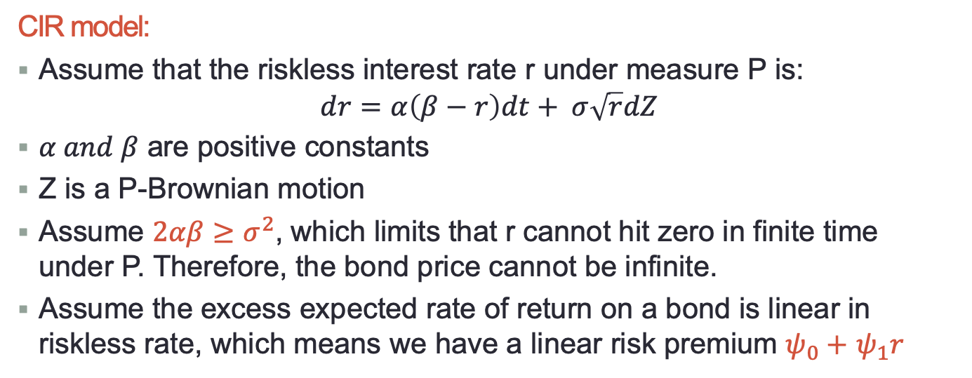
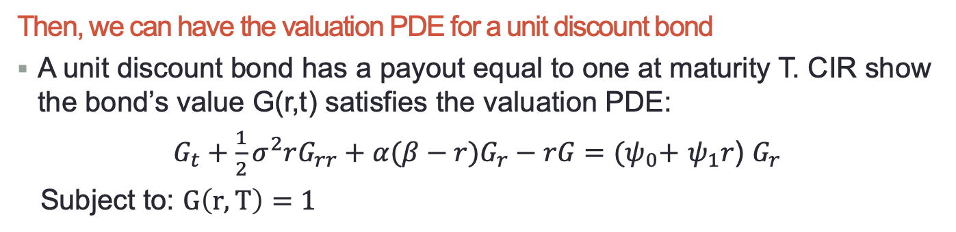
Let me show you a bubble
CIR model:
Assume that the riskless interest rate r under measure P is:
$$dr=α\left(β−r\right)dt+ σ\sqrt{r}dZ$$
$α and β$ are positive constants
Z is a P-Brownian motion
Assume $2αβ≥σ^{2}$, which limits that r cannot hit zero in finite time under P. Therefore, the bond price cannot be infinite.
Assume the excess expected rate of return on a bond is linear in riskless rate, which means we have a linear risk premium $ψ_{0}+$ $ψ_{1}r$
Then, we can have the valuation PDE for a unit discount bond
A unit discount bond has a payout equal to one at maturity T. CIR show the bond’s value G(r,t) satisfies the valuation PDE:
$G_{t}+\frac{1}{2}σ^{2}rG_{rr}+α(β−r)G_{r}−rG=$ ${(ψ}_{0}+$ $ψ_{1}r$) $G_{r}$
Subject to: $G\left(r,T\right)=1$

Slide 5
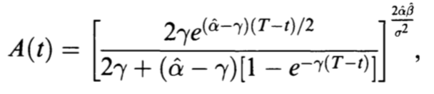
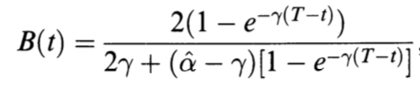



Let me show you a bubble
$G_{t}+\frac{1}{2}σ^{2}rG_{rr}+α(β−r)G_{r}−rG=$ ${(ψ}_{0}+$ $ψ_{1}r$) $G_{r}$
One solution:
$$G^{1}\left(r,t\right)=A\left(t\right)e^{−B\left(t\right)r}$$
Where $\hat{α}= α+$ $ψ_{1}$ and $\hat{β}=(αβ−$ $ψ_{0})/(α+$ $ψ_{1}$)
Then, something interesting happened:
When $2αβ≥σ^{2}$ and $2\hat{α}\hat{β}<σ^{2}$ hold, we can have a cheaper solution!!

Slide 6
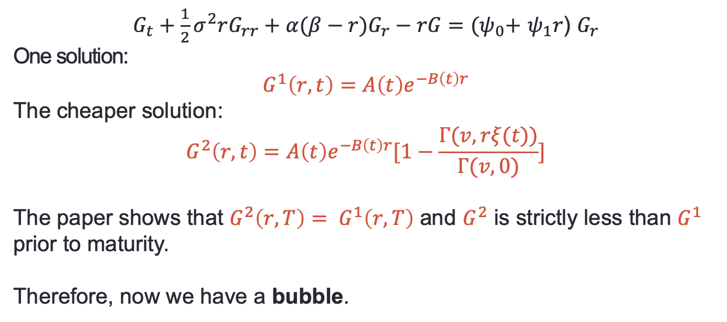
Let me show you a bubble
$G_{t}+\frac{1}{2}σ^{2}rG_{rr}+α(β−r)G_{r}−rG=$ ${(ψ}_{0}+$ $ψ_{1}r$) $G_{r}$
One solution:
$$G^{1}\left(r,t\right)=A\left(t\right)e^{−B\left(t\right)r}$$
The cheaper solution:
$$G^{2}\left(r,t\right)=A\left(t\right)e^{−B\left(t\right)r}[1−\frac{Γ(v,rξ(t))}{Γ(v,0)}]$$
The paper shows that $G^{2}\left(r,T\right)= G^{1}\left(r,T\right)$ and $G^{2}$ is strictly less than $G^{1}$ prior to maturity.
Therefore, now we have a bubble.

Slide 7
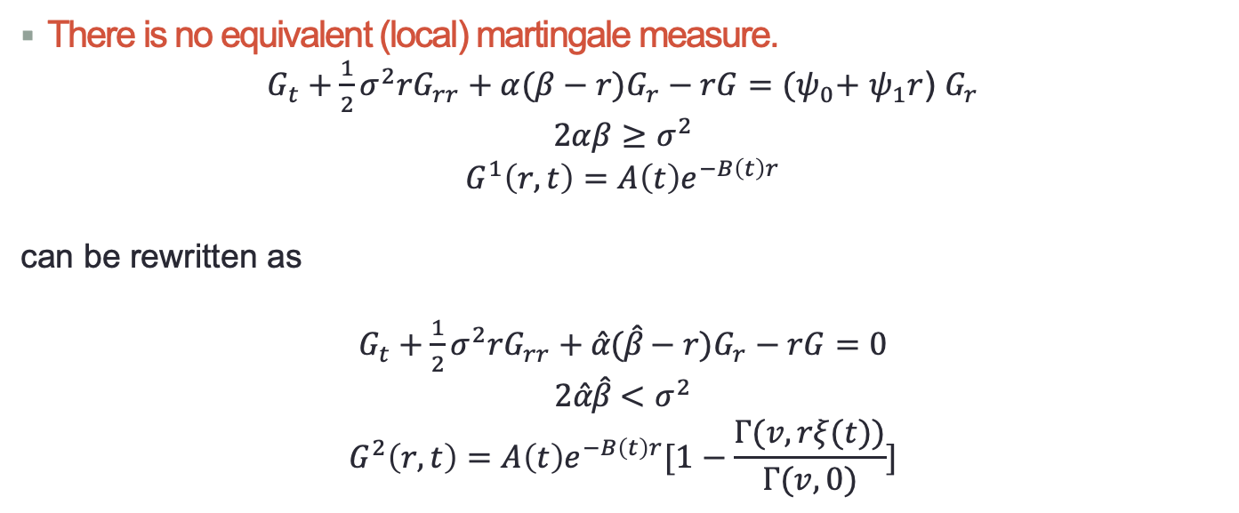
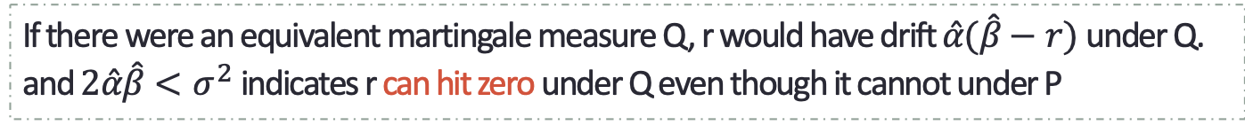
Some facts
There is no equivalent (local) martingale measure.
$G_{t}+\frac{1}{2}σ^{2}rG_{rr}+α(β−r)G_{r}−rG=$ ${(ψ}_{0}+$ $ψ_{1}r$) $G_{r}$
$$2αβ≥σ^{2}$$
$$G^{1}\left(r,t\right)=A\left(t\right)e^{−B\left(t\right)r}$$
can be rewritten as
$G_{t}+\frac{1}{2}σ^{2}rG_{rr}+\hat{α}(\hat{β}−r)G_{r}−rG=$ $0$
$$2\hat{α}\hat{β}<σ^{2}$$
$$G^{2}\left(r,t\right)=A\left(t\right)e^{−B\left(t\right)r}[1−\frac{Γ(v,rξ(t))}{Γ(v,0)}]$$
If there were an equivalent martingale measure Q, r would have drift $\hat{α}(\hat{β}−r)$ under Q. and $2\hat{α}\hat{β}<σ^{2}$ indicates r can hit zero under Q even though it cannot under P
Therefore, $G^{1}$ - $G^{2}$ would represent the price of a claim that pays 1 dollar if the interest rate hits zero prior to maturity.

Slide 8
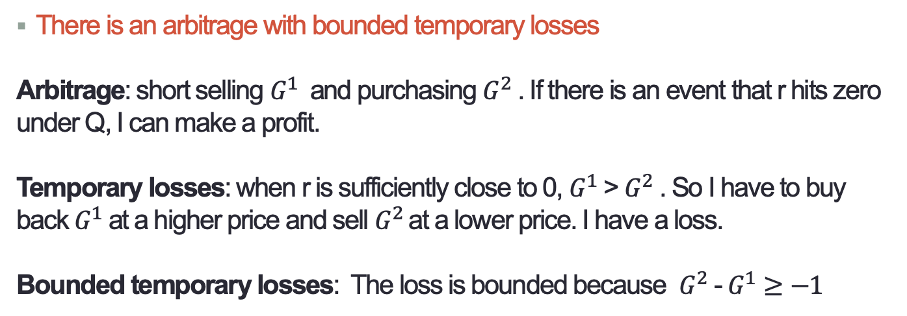
Some facts
There is an arbitrage with bounded temporary losses
Arbitrage: short selling $G^{1}$ and purchasing $G^{2}$ . If there is an event that r hits zero under Q, I can make a profit.
Temporary losses: when r is sufficiently close to 0, $G^{1}$ > $G^{2}$ . So I have to buy back $G^{1}$ at a higher price and sell $G^{2}$at a lower price. I have a loss.
Bounded temporary losses: The loss is bounded because $G^{2}$ - $G^{1}≥−1$
Therefore, if the arbitrage is feasible at a large scale, we have to prepare for a negative wealth.

Slide 9
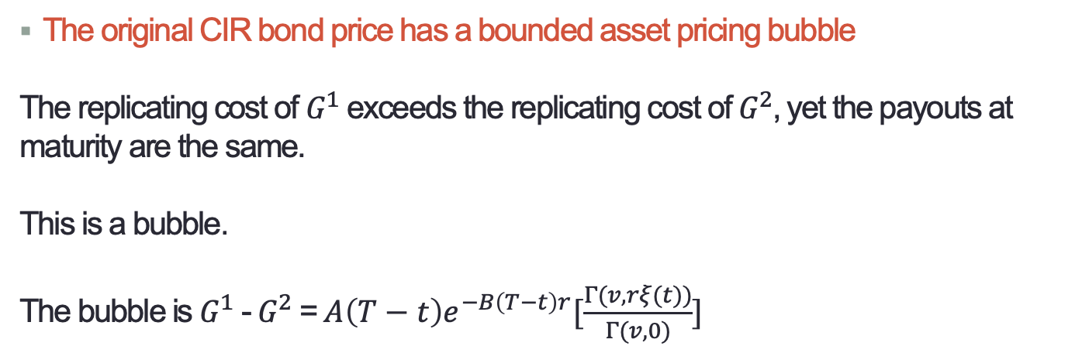
Some facts
The original CIR bond price has a bounded asset pricing bubble
The replicating cost of $G^{1}$ exceeds the replicating cost of $G^{2}$, yet the payouts at maturity are the same.
This is a bubble.
The bubble is $G^{1}$ - $G^{2}$ = $A\left(T−t\right)e^{−B\left(T−t\right)r}[\frac{Γ(v,rξ(t))}{Γ(v,0)}]$
Therefore, the bubble is bounded above by 1.

Slide 10
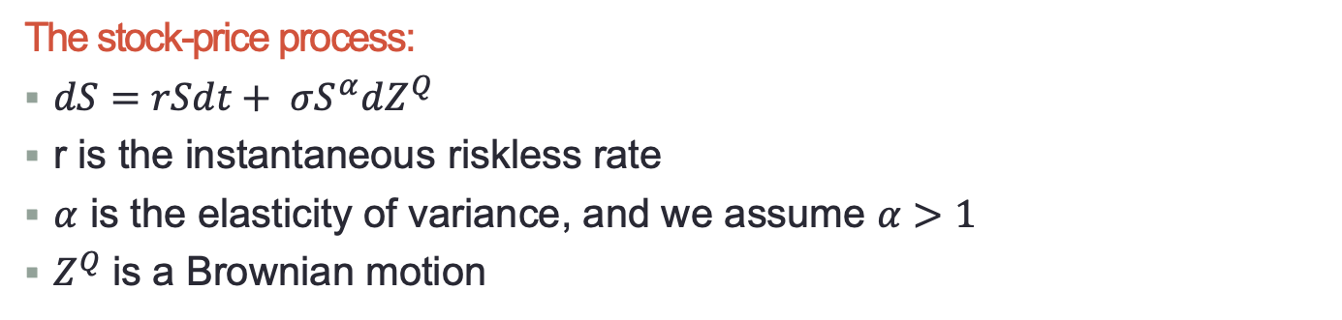
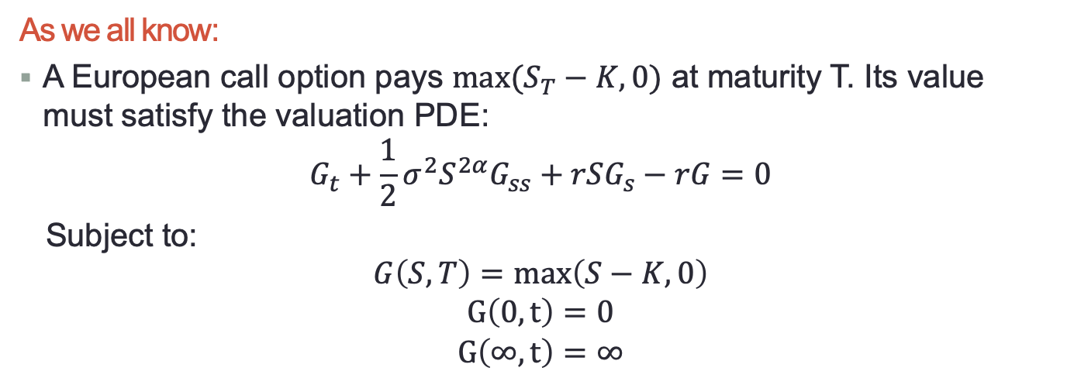
Bubbles on stock and option values
The stock-price process:
$dS=rSdt+ σS^{α}dZ^{Q}$
r is the instantaneous riskless rate
$α$ is the elasticity of variance, and we assume $α>1$
$Z^{Q}$ is a Brownian motion
As we all know:
A European call option pays $max⁡(S_{T}−K,0)$ at maturity T. Its value must satisfy the valuation PDE:
$$G_{t}+\frac{1}{2}σ^{2}S^{2α}G_{ss}+rSG_{s}−rG=0$$
Subject to:
$$G\left(S,T\right)=\max\left(S−K,0\right)$$
$$G\left(0,t\right)=0$$
$$G\left(∞,t\right)=∞$$

Slide 11
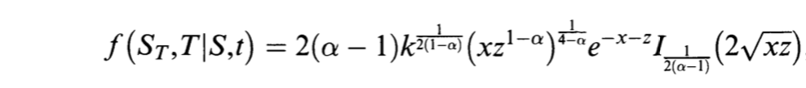

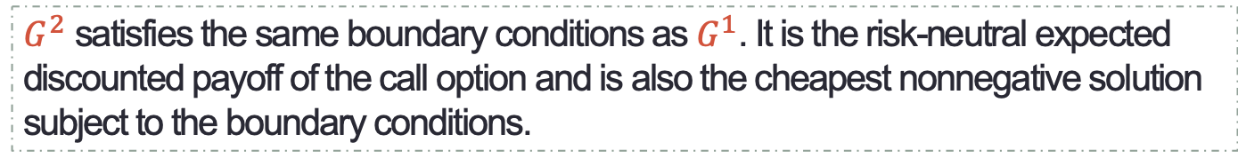
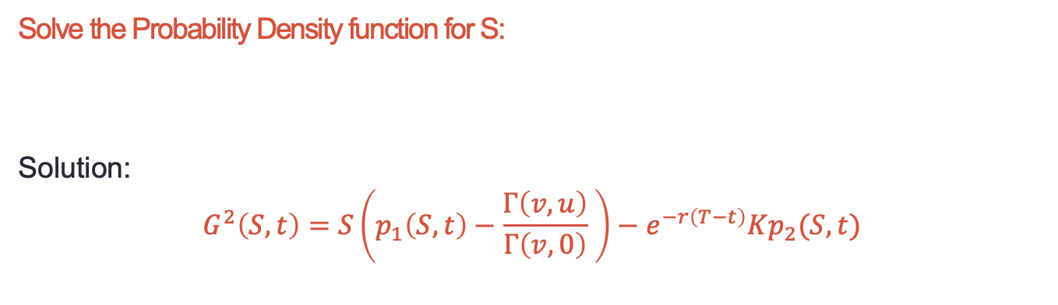
Bubbles on stock and option values
Solve the PDE:
$$G_{t}+\frac{1}{2}σ^{2}S^{2α}G_{ss}+rSG_{s}−rG=0$$
Solution:
$$G^{1}\left(S,t\right)=Sp_{1}\left(S,t\right)− e^{−r\left(T−t\right)}Kp_{2}(S,t)$$
Solve the Probability Density function for S:
Solution:
$$G^{2}\left(S,t\right)=S\left(p_{1}\left(S,t\right)−\frac{Γ\left(v,u\right)}{Γ\left(v,0\right)} \right)−e^{−r\left(T−t\right)}Kp_{2}(S,t)$$
$G^{2}$ satisfies the same boundary conditions as $G^{1}$. It is the risk-neutral expected discounted payoff of the call option and is also the cheapest nonnegative solution subject to the boundary conditions.

Slide 12
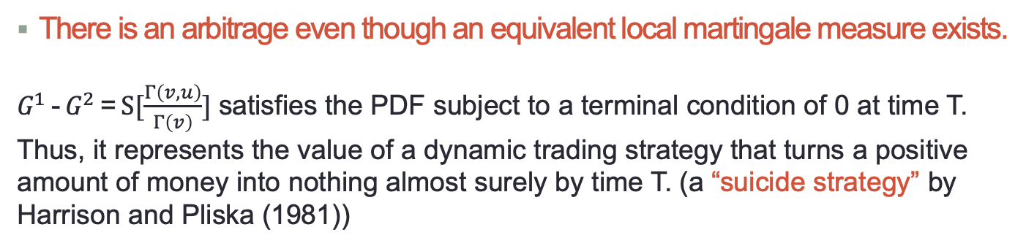
Some facts
There is an arbitrage even though an equivalent local martingale measure exists.
$G^{1}$ - $G^{2}$ = $S[\frac{Γ\left(v,u\right)}{Γ\left(v\right)}]$ satisfies the PDF subject to a terminal condition of 0 at time T. Thus, it represents the value of a dynamic trading strategy that turns a positive amount of money into nothing almost surely by time T. (a “suicide strategy” by Harrison and Pliska (1981))
A reverse position will be a good strategy but it risks unbounded temporary losses prior to closure.
Therefore, this arbitrage is infeasible for an investor prohibited from risking unbounded marked-to-market dollar losses, and infeasible for those with no ability to short sell the stock.

Slide 13
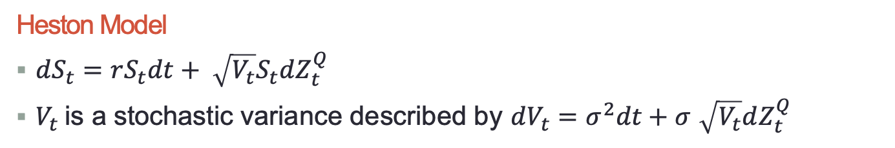
Bubbles just on option values
Heston Model
$dS_{t}=rS_{t}dt+ \sqrt{V_{t}}S_{t}dZ_{t}^{Q}$
$V_{t}$is a stochastic variance described by $dV_{t}=σ^{2}dt+σ$ $\sqrt{V_{t}}dZ_{t}^{Q}$
Facts:
An equivalent risk-neutral measure Q exists, so there are no bond bubbles.
The discounted stock price is a martingale under Q, so there are no stock price bubbles either.
HOWEVER, option values can still have bubbles associated with multiple PDE solutions.

Slide 14
Bubbles can appear on any combination of bond prices, stock prices, or option values

Slide 15
Contents
1 Where are bubbles
2 How to rule out bubbles
3 Options and bubbles
4 Conclusion

Slide 16
How to rule out bubbles
We provide three conditions to limit our model
The price of risk is finite. People cannot make a profit instantaneously without the risk of loss.
Rule out the money market bubbles
Rule out the stock bubbles
How to present these conditions mathematically?

Slide 17
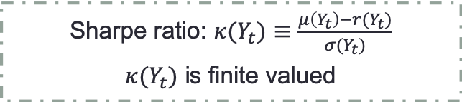
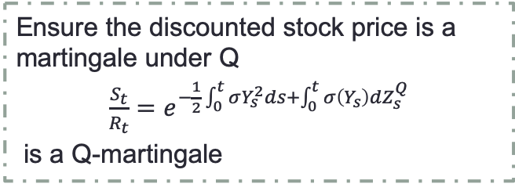
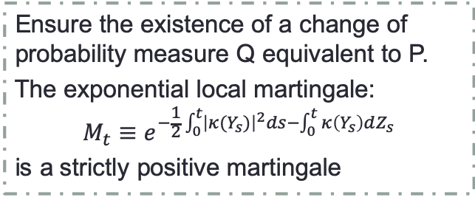
How to rule out bubbles
Condition 1: the price of risk is finite.
Sharpe ratio: $κ(Y_{t})≡\frac{μ\left(Y_{t}\right)−r(Y_{t})}{σ(Y_{t})}$
$κ(Y_{t})$ is finite valued
Condition 1 holds
Condition 2: rule out the money market bubbles.
Ensure the existence of a change of probability measure Q equivalent to P.
The exponential local martingale:
$$M_{t}≡e^{−\frac{1}{2}\int_{0}^{t}{{\left|κ(Y_{s})\right|}^{2}ds−\int_{0}^{t}{κ\left(Y_{s}\right)dZ_{s}}}}$$
is a strictly positive martingale
Condition 2 holds
Condition 3: rule out the stock bubbles.
Ensure the discounted stock price is a martingale under Q
$\frac{S_{t}}{R_{t}}=$ $e^{−\frac{1}{2}\int_{0}^{t}{σY_{s}^{2}ds+\int_{0}^{t}{σ\left(Y_{s}\right)dZ_{s}^{Q}}}}$
is a Q-martingale
Condition 3 holds

Slide 18
Contents
1 Where are bubbles
2 How to rule out bubbles
3 Options and bubbles
4 Conclusion

Slide 19
Options and bubbles
Option textbooks typically present ”universal” properties of option values based on seemingly weak assumptions about underlying spot prices.
But the possibility of multiple solutions of the valuation PDE might mean that some solutions satisfy these properties, whereas others do not.

Slide 20
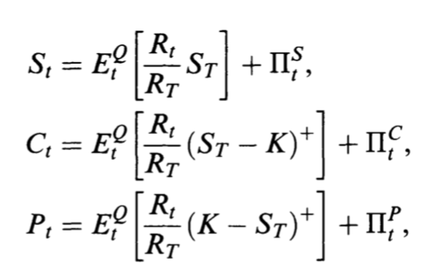

Options and bubbles
Example 1: Put-Call Parity
Where $Π^{S},$ $Π^{C}$, $Π^{P}$ represent bubbles on the stock, the call, and the put.
Put-Call Parity:
$$C_{t}+KE_{t}^{Q}\left[\frac{R_{t}}{R_{T}}\right]=P_{t}+ S_{t}$$
Which implies:
$$Π_{t}^{S}+Π_{t}^{P}=Π_{t}^{C}$$
Therefore, The put-call parity might or might not hold if prices include bubbles.
.

Slide 21
Options and bubbles
Example 2: American options
As we all know: it is not optimal to exercise early an American call option on a stock that pays no dividends.
With stock bubbles: there is no optimal exercise policy at all.
Since instead of waiting until maturity, one would prefer to sell the American option before the stock bubble “bursts”.

Slide 22
Contents
1 Where are bubbles
2 How to rule out bubbles
3 Options and bubbles
4 Conclusion

Slide 23
Conclusion and my opinions
Multiple PDE solutions imply distinct strategies that exactly replicate identical option payoffs at different costs.
Asset pricing bubbles exist, but can be ruled out by presenting meaningful conditions.
We cannot ignore the existence of bubbles and we should develop techniques that would be helpful in determining appropriate models for the purposes of option valuation.

Slide 24
Q & A

Slide 25
Thank you！

